Slide 1
Shape from X
Computer vision
Guided by: Dr. Sabri
Presentor: Heydar Mahmoodi

Slide 2
agenda
Introduction
Shape from Shading
Shape from Motion
Shape from Texture
Shape from Contour
Shape from Focus (SfF)
Shape from Stereopsis
Shape from Reflection
Shape from Infrared (SfIR)
Shape from Sound (SfSd)
Shape from X-ray or CT Scan
Photometric Stereo
Comparison of SfS and PS
Applications of Shape from X
Challenges and Future Directions
Related Works and Notable Researchers
Conclusion

Slide 3
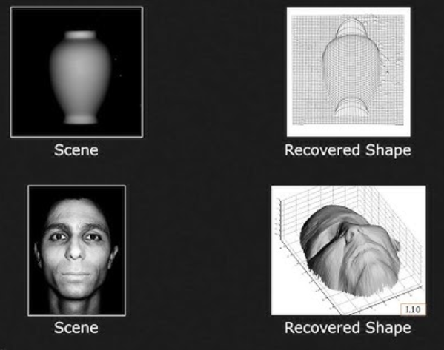
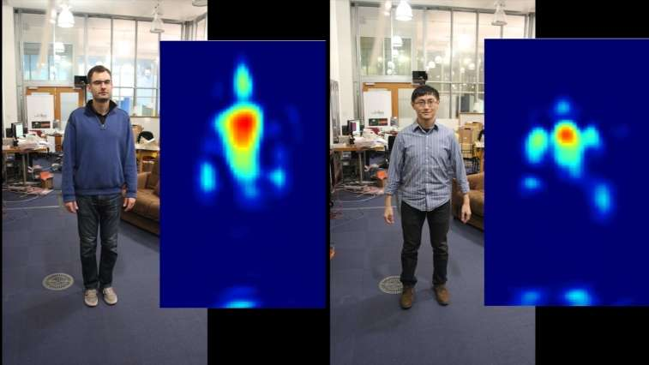
Introduction
Various methods of deriving three-dimensional shape information from two-dimensional images or data.

Slide 4
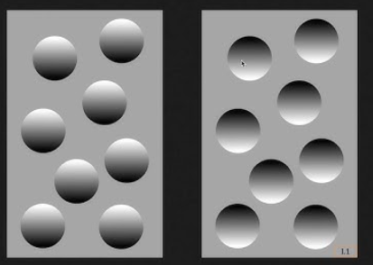
Why Attention?
"Existing techniques for extracting 3D information from 2D images are good, but not good enough,"
says Tianfu Wu, co-author of a paper on the work and an associate professor of electrical and computer engineering at North Carolina State

Slide 5
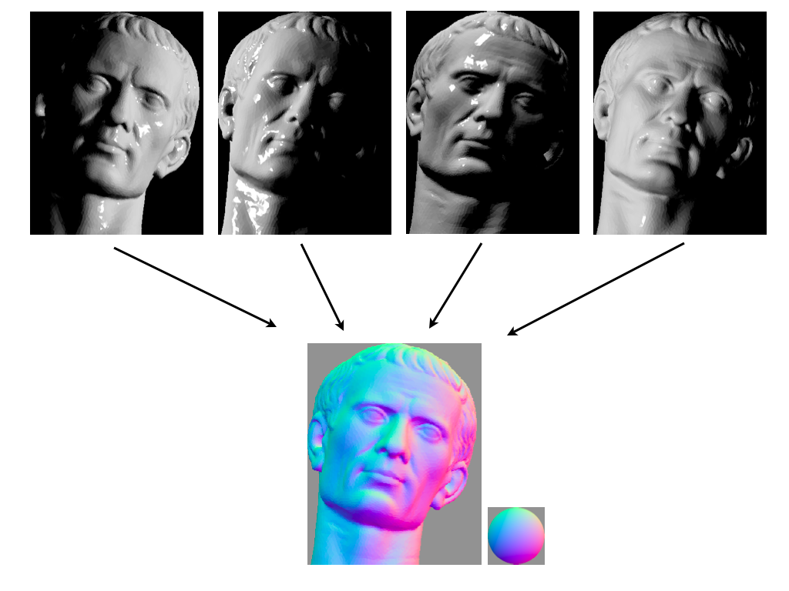
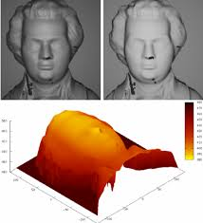
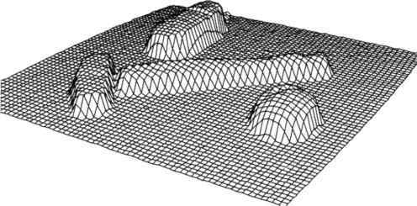
Shape from Shading
Determining the 3D shape of an object by analyzing the variations in brightness and shading in an image.
Explanatory diagram of photometric stereo. Multiple images of an object under different lighting are analyzed to produce an estimated normal direction at each pixel.

Slide 6
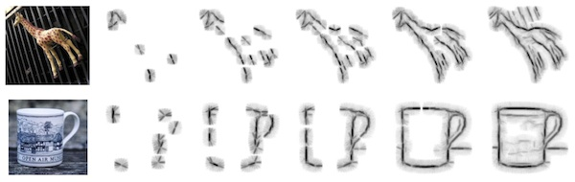
Shape from Contour
Reconstructing the 3D shape of an object by examining the edges and contours in an image.

Slide 7
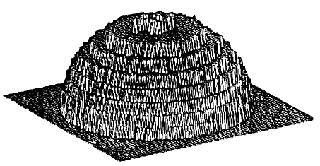
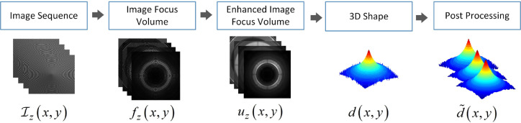
Shape from Focus (SfF)
Obtaining the 3D shape of an object by analyzing the variations in focus or depth of field in images.
Shape from focus or shape from defocus is a method of 3D reconstruction which consists of the use of information about the focus of an optical system to provide a means of measurement for 3D information. One of the simplest forms of this method can be found in most autofocus cameras today.

Slide 8
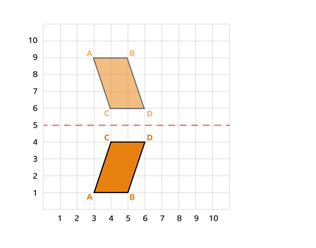
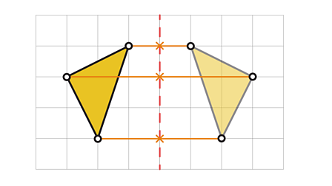
Shape from Reflection
Inferring the shape of an object by examining how it reflects light or other electromagnetic waves.

Slide 9
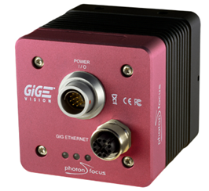
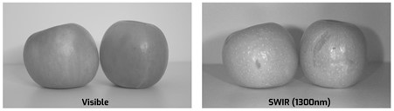
Shape from Infrared (SfIR)
Same as Shape from Reflection
Short-Wave Infrared (SWIR)
Where is usefull? Non-visible area.(for example in the night)
Problem: IR can make the object warmer … Link
SWIR Cameras from PhotonFocus

Slide 10
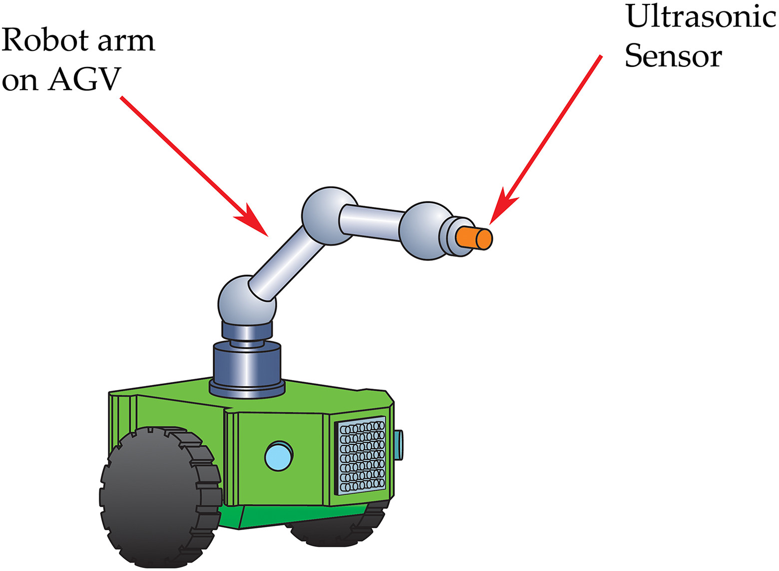
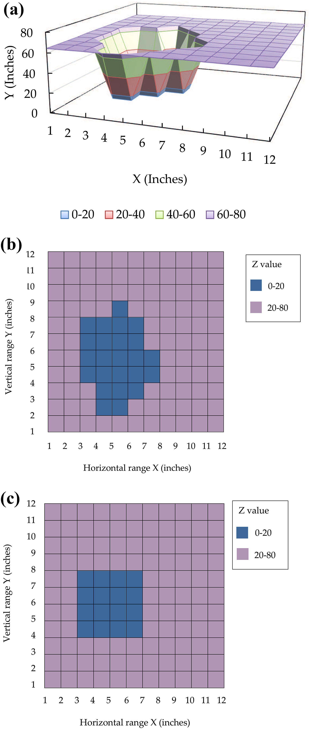
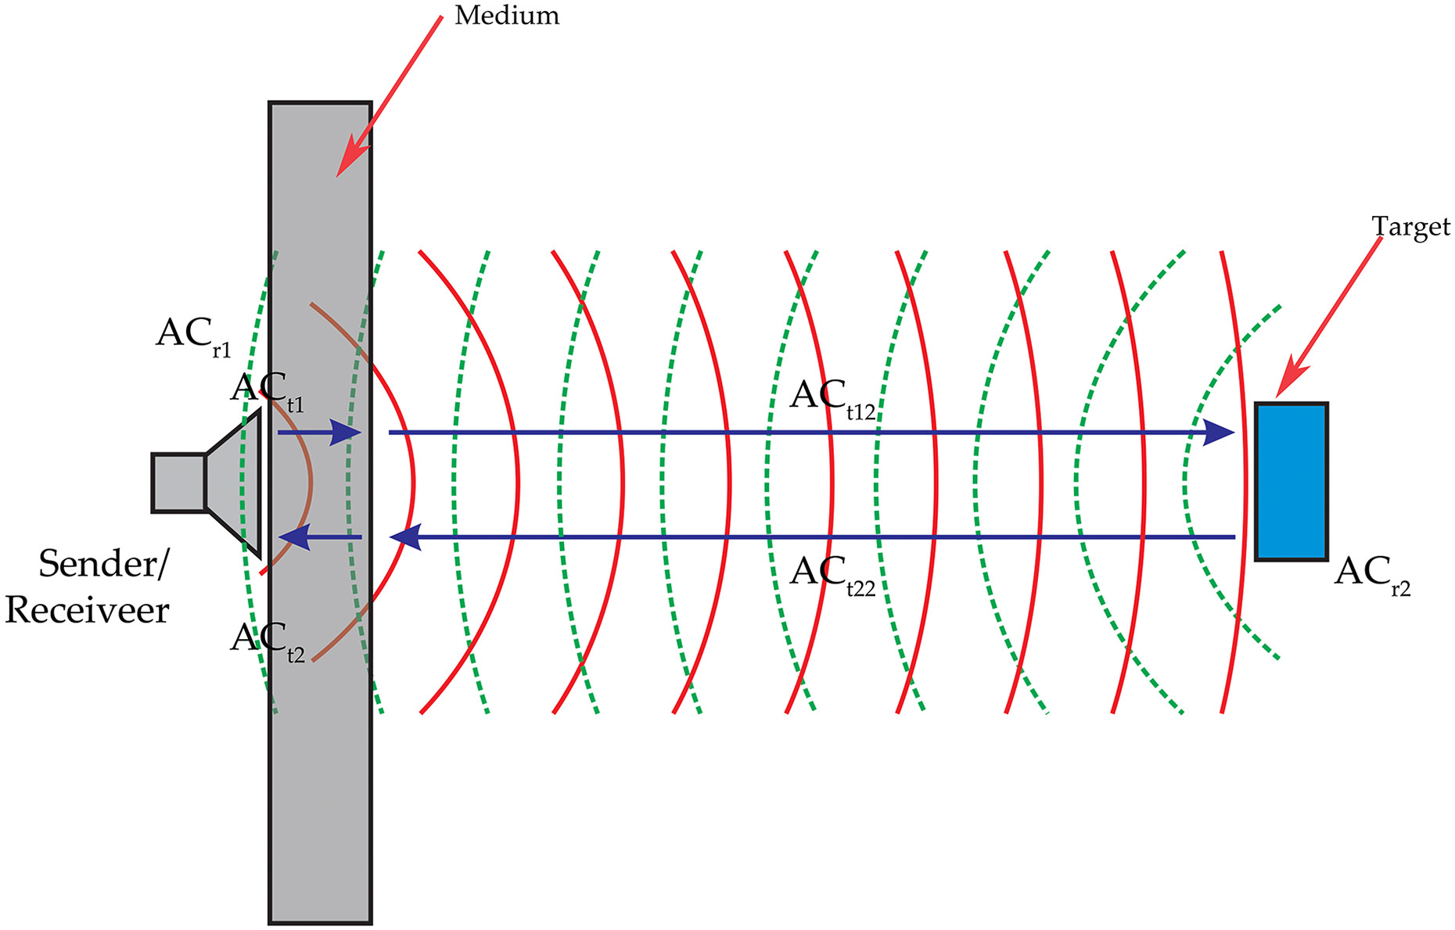
Shape from Sound (SfSd)
Estimating 3D shapes through the analysis of sound waves or echoes, often used in applications like sonar and echolocation.
Where is usefull? Non-visible area.(no light for example)

Slide 11
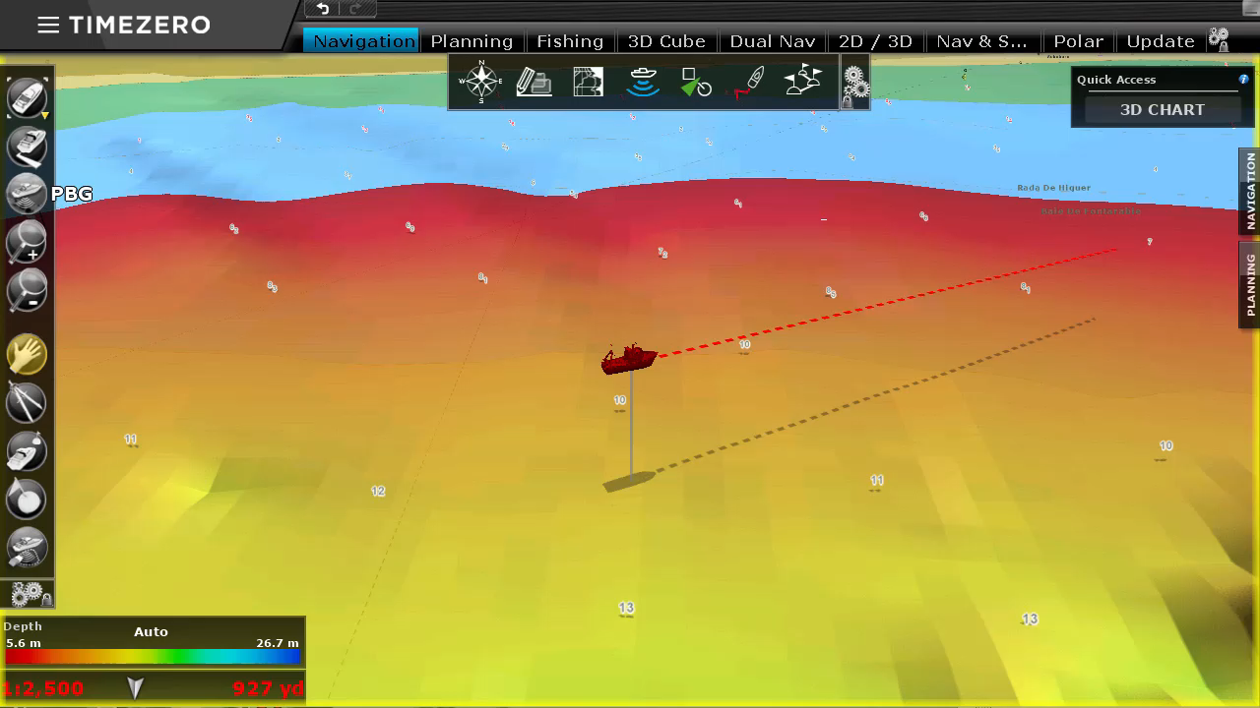
Shape from Sound (CONT…)

Slide 12
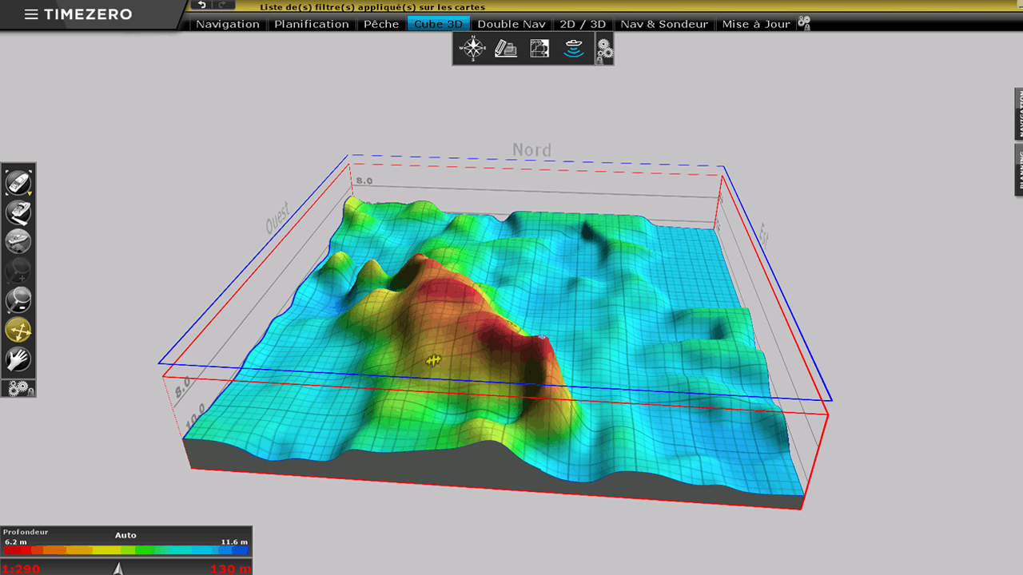

Slide 13
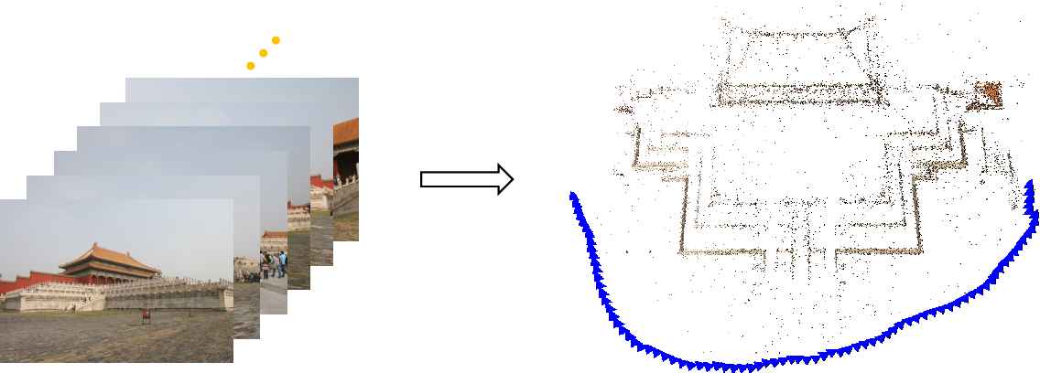
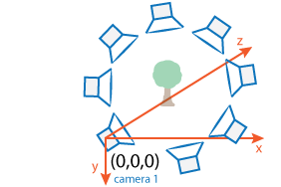
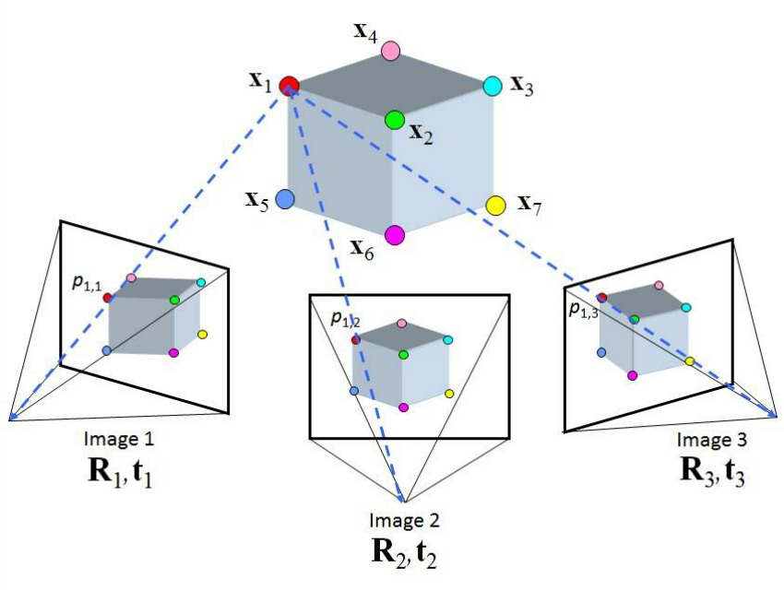
Shape from Motion
Inferring the three-dimensional shape of objects by tracking their movement or motion over time.

Slide 14
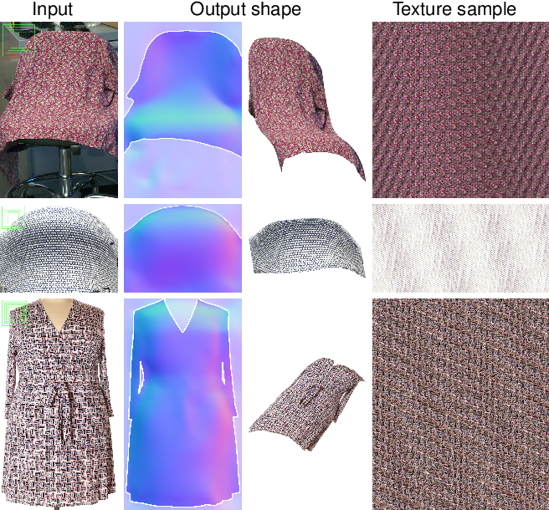
Shape from Texture
Estimating the 3D shape of an object by analyzing the patterns and texture in its surface.
In practice, implementing a complete SfT algorithm involves several complex steps, including camera calibration, dealing with different lighting conditions, and potentially using specialized libraries or custom code for depth integration.

Slide 15
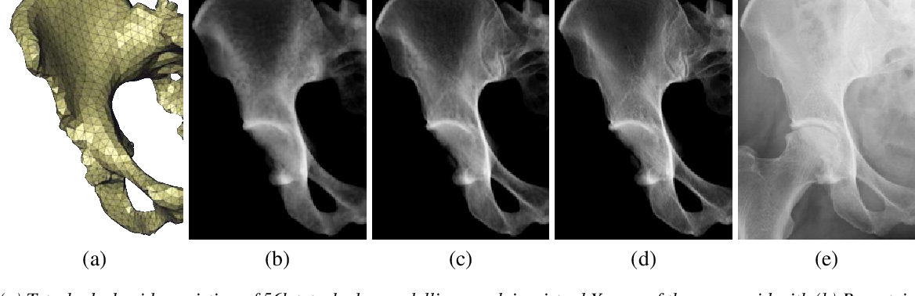
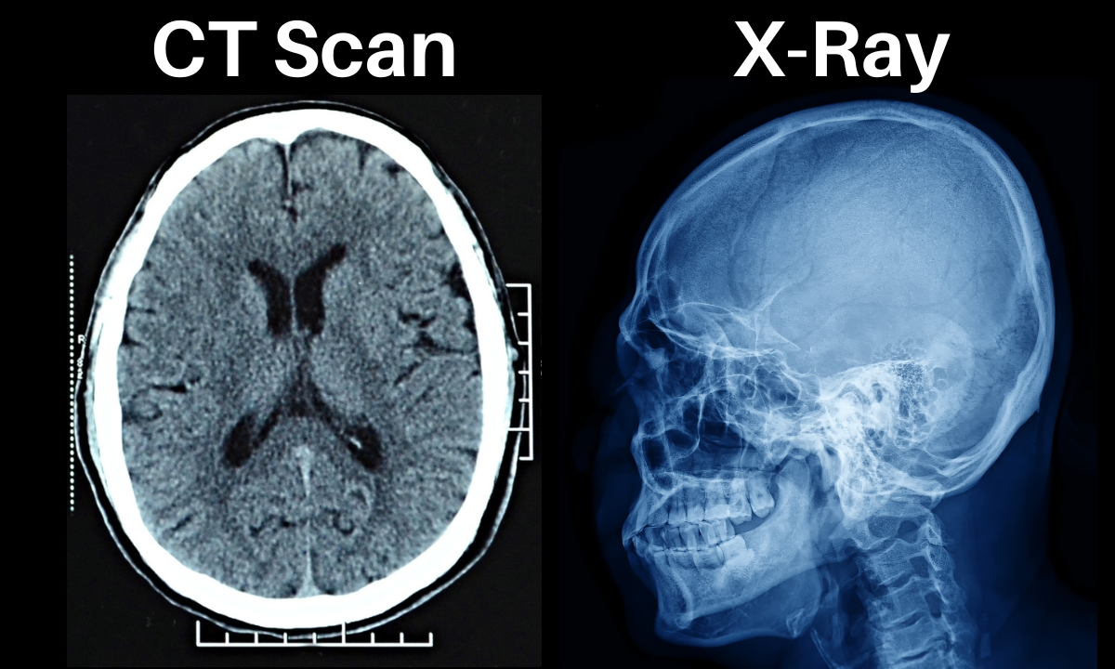
Shape from X-ray or CT Scan
Reconstructing the internal and external 3D structure of objects or organisms by using X-rays or computed tomography (CT) scans to analyze the attenuation of X-ray beams through the object.

Slide 16
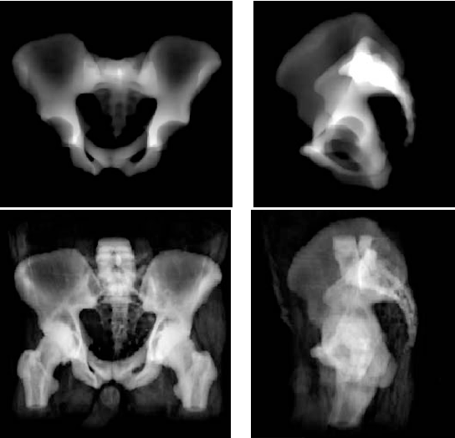
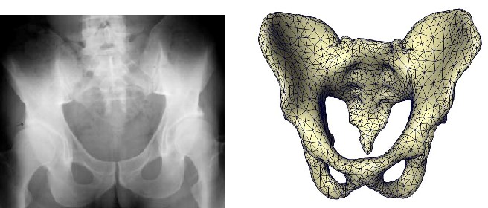
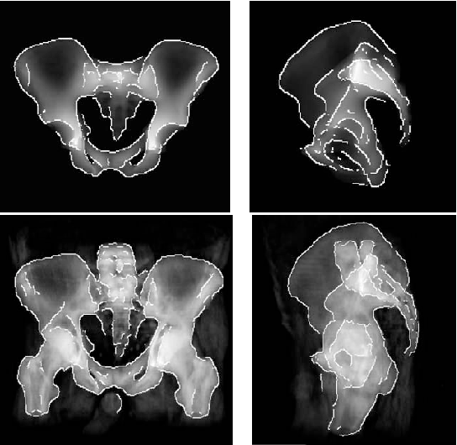
Shape from X-ray or CT Scan

Slide 17
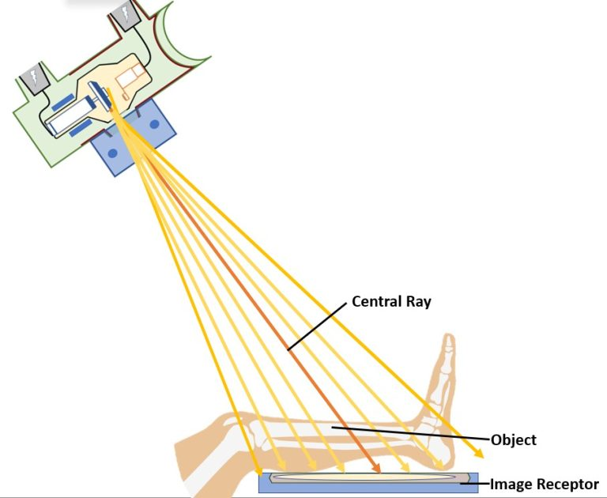
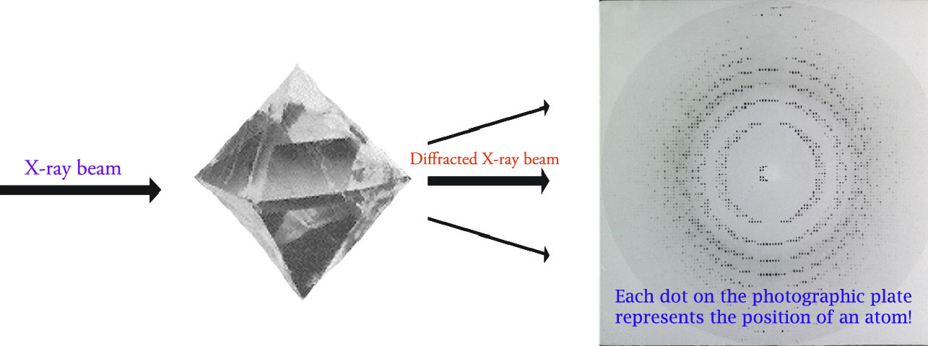
Shape from X-ray or CT Scan
https://www.cif.iastate.edu/sites/default/files/uploads/ACIDE/xrd1.jpg
XRD finds the geometry or shape of a molecule using X-rays. XRD techniques are based on the elastic scattering of X-rays from structures that have long range order. The X-rays get diffracted by a crystal because the wavelength of X-rays is similar to the inter-atomic spacing in the crystals.

Slide 18
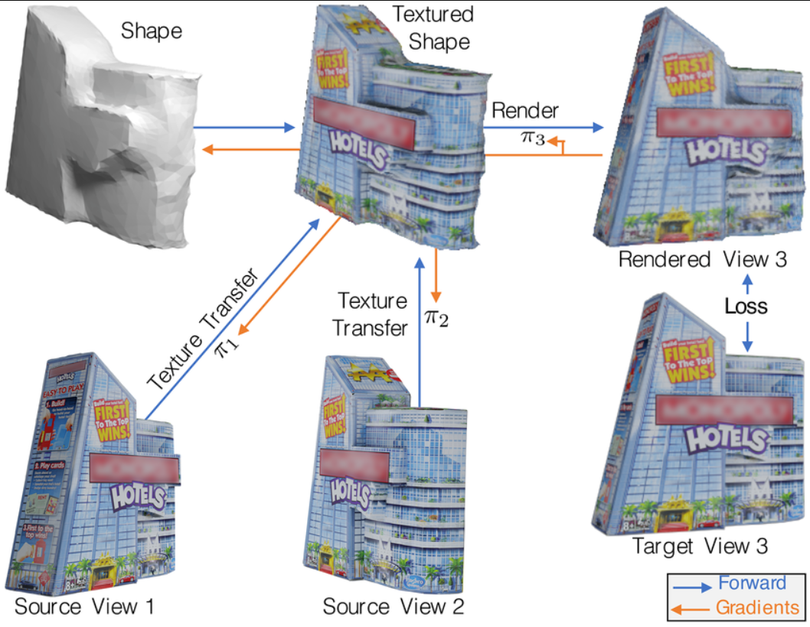
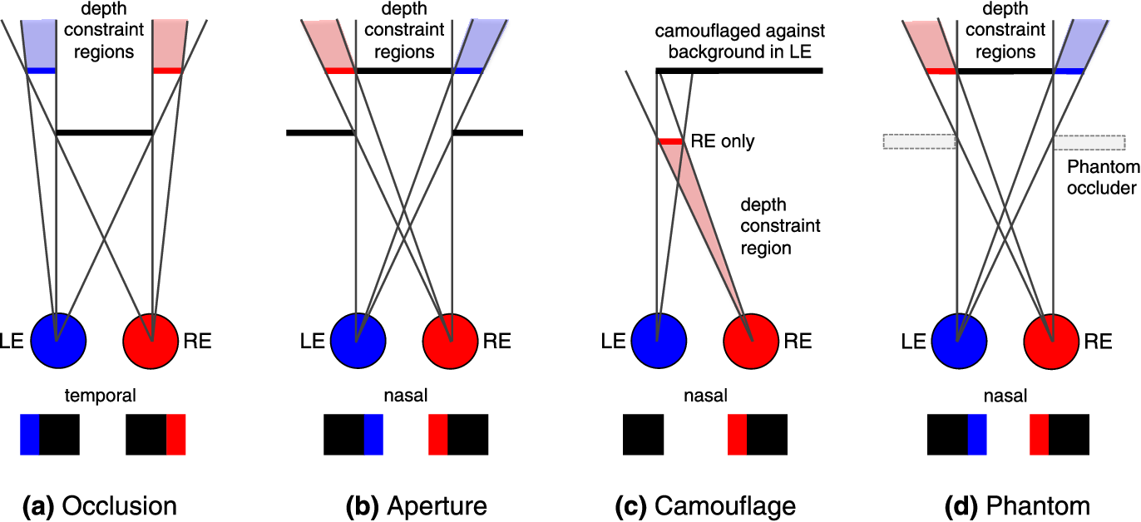
Shape from Stereopsis
Determining the 3D structure of objects by comparing the disparities or differences in the images seen by both eyes, which is the basis of human stereoscopic vision.
Check more info: HLink

Slide 19
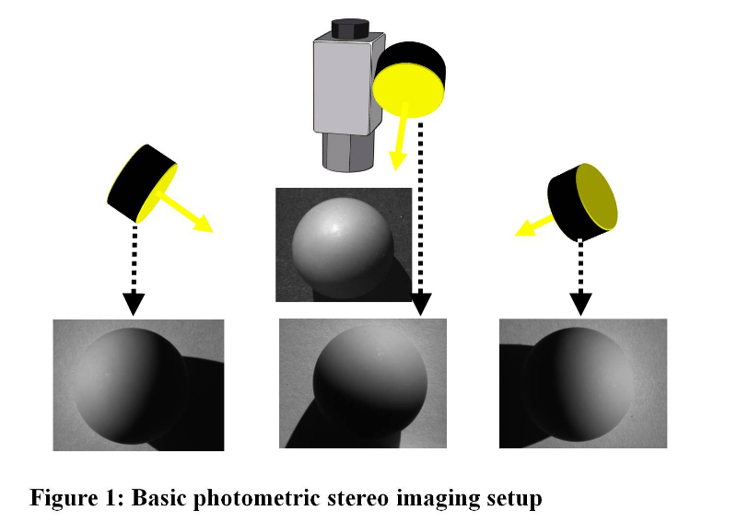
Photometric Stereo
A technique that calculates the surface normals and 3D shape of an object by capturing multiple images of the same object under different lighting conditions and analyzing how the object's appearance changes with varying lighting angles.

Slide 20
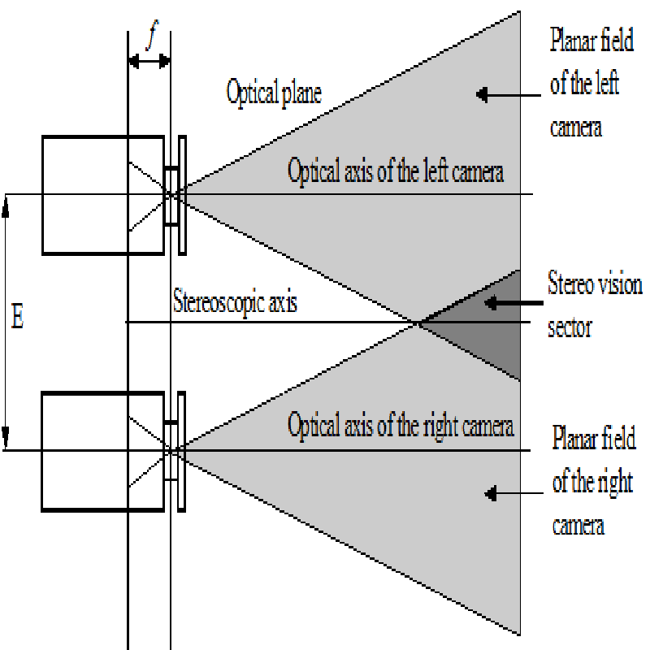
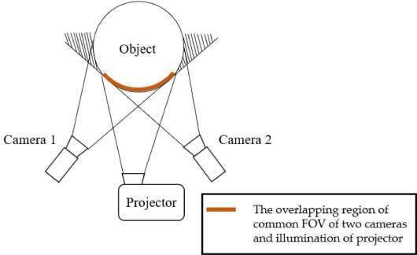
Stereo Idea

Slide 21
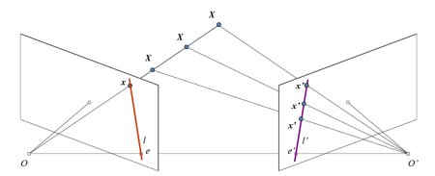
Epipolar Idea

Slide 22
Method | Pros | Cons | Applications
Shape from Shading | - Works with single images | - Sensitivity to lighting conditions | Robotics, surface inspection
Shape from Motion | - Can work in dynamic scenes | - Requires moving objects or camera | Motion tracking, 3D reconstruction
Shape from Texture | - Works well with textured surfaces | - Limited applicability on uniform surfaces | Object recognition, surface analysis
Shape from Contour | - Extracts detailed object boundaries | - Sensitive to noise and occlusions | Object recognition, edge detection
Shape from Focus | - Accurate depth estimation | - Requires multiple images with different focus settings | Microscopy, depth estimation
Shape from Stereopsis | - Provides accurate depth information | - Requires calibration and known camera parameters | 3D modeling, depth perception
Shape from Reflection | - Infers shape from specularities | - Limited applicability on non-reflective surfaces | Surface quality inspection, material analysis
Shape from Infrared | - Works in low-light or dark environments | - Limited details about surface characteristics | Night vision, surveillance
Shape from Sound | - Penetrates through obstacles | - Limited accuracy in complex environments | Echolocation, underwater mapping
Shape from X-ray/CT | - Reveals internal structure | - Radiation exposure, specialized equipment | Medical imaging, material analysis
Photometric Stereo | - Accurate surface normal estimation | - Requires controlled lighting conditions | Surface inspection, facial recognition

Slide 23
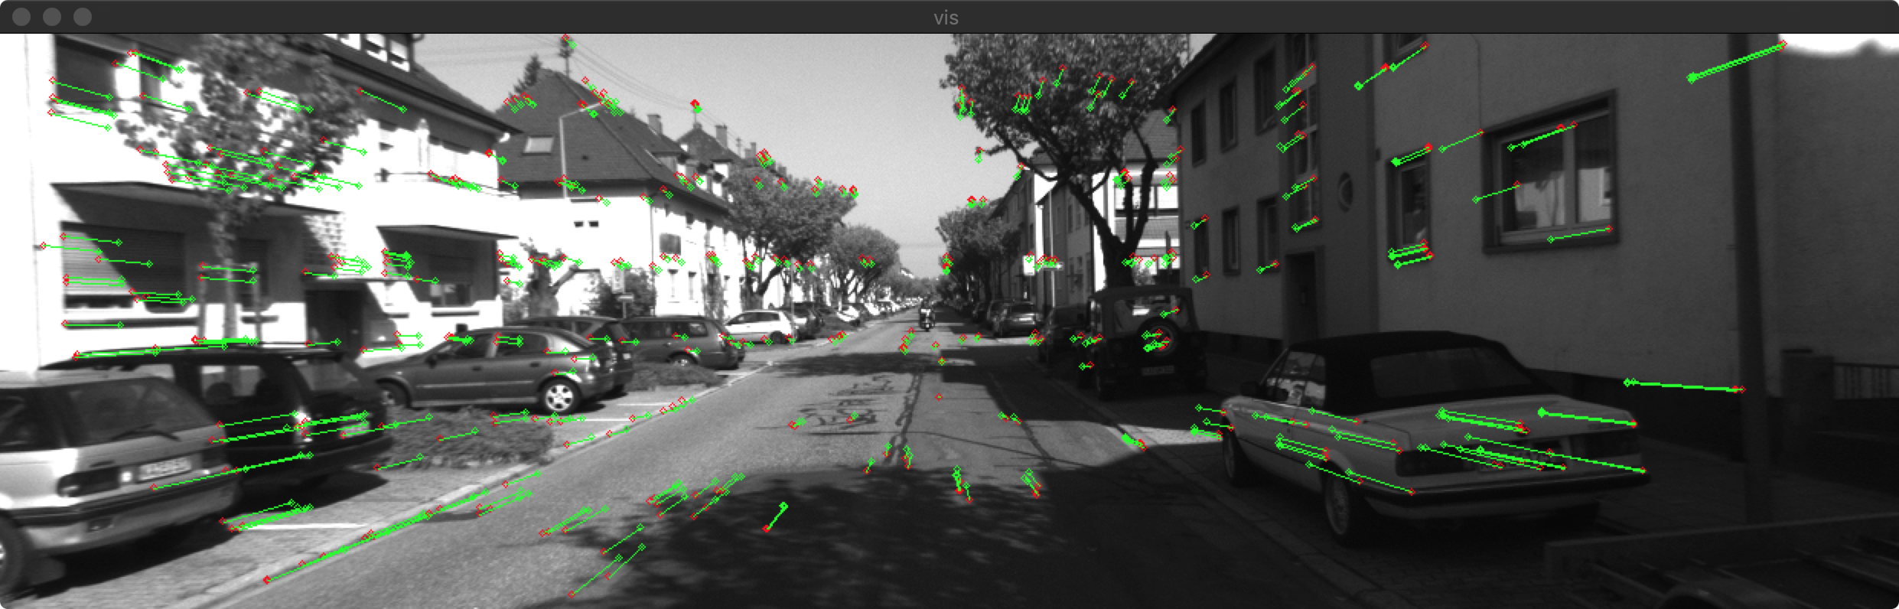
Applications of Shape from X
Autopilot (i.e:Tesla cars)
Sonars 3d reconstruction (i.e: fishing bussinness)
AR/VR , AR Games
Metaverse
Google earth
Automated guided vehicle
Medical Diagnosis
etc

Slide 24
Algorithms
MonoCular Estimation → Single images
Stereo Estimation → multiple images

Slide 25
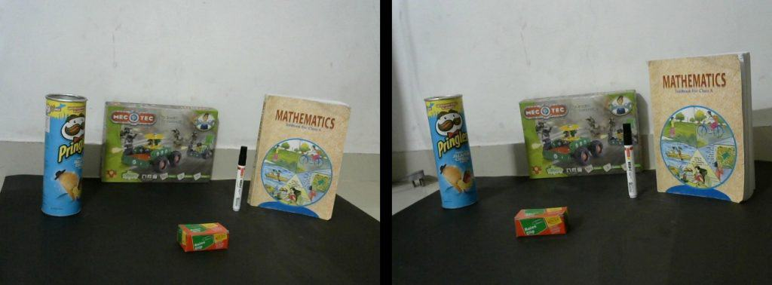
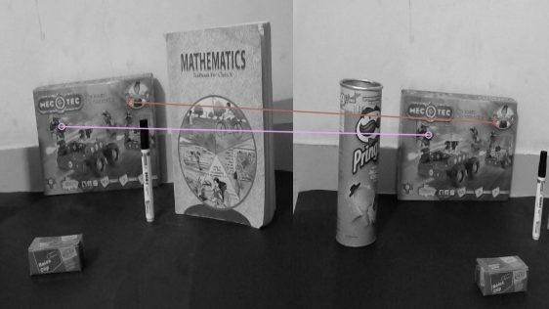
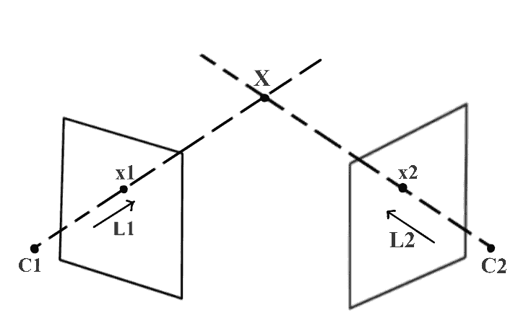
Photometric Stereo (Cont…)
Original images
Hand picked feature matches.

Slide 26
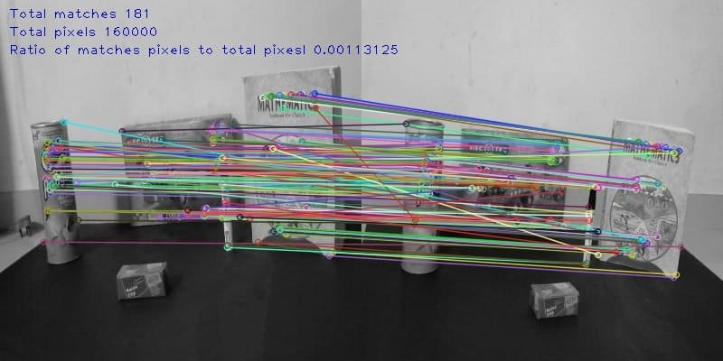
Photometric Stereo (Cont…)
Results of feature detection algorithm

Slide 27
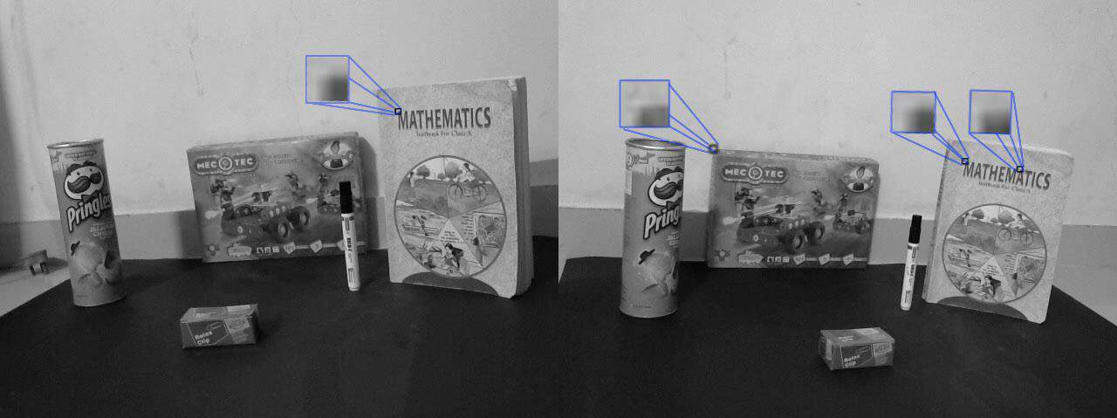
template matching
Multiple matched points using template matching.

Slide 28
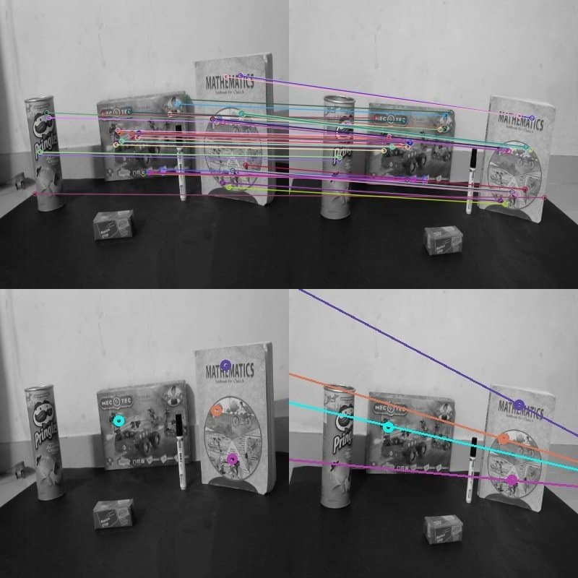
epipolar lines
Finding epipolar lines

Slide 29
Recovering 3d shape from PS
Method for recovering shape3d from image intensities measured using multiple sources.(reflecting properties in diffrenet light sources)
Gradient space & Reflectance map
Photometric stereo
Calibration based photometric stereo
Shape from surface normal

Slide 30
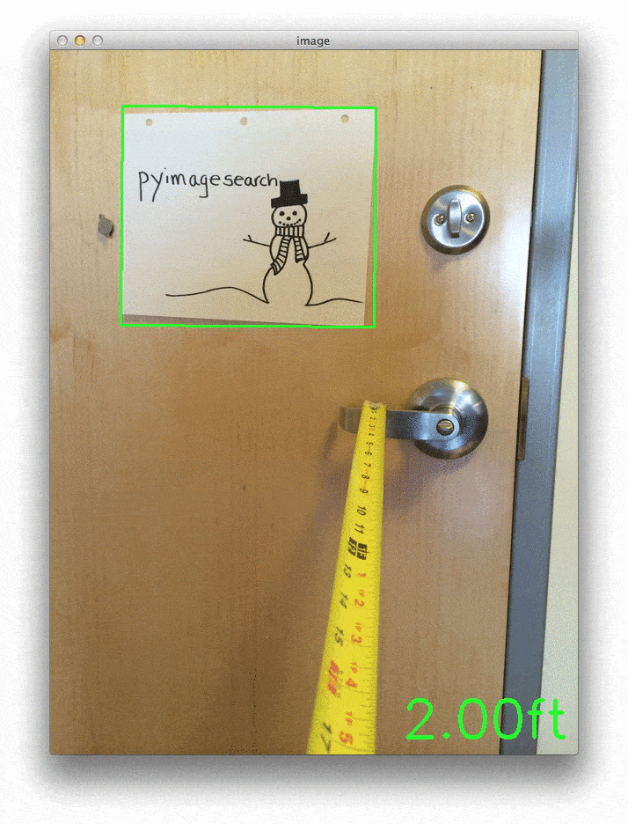
Depth in camera
Sometimes you want to using some kits to achieve this option, the stereo camera setup of OAK-D (OpenCV AI Kit- Depth) can be used to help the computer perceive depth.
https://www.kickstarter.com/projects/opencv/opencv-ai-kit
https://pyimagesearch.com/wp-content/uploads/2014/12/distance_to_camera_animated.gif

Slide 31
Challenges and Future Directions
Discussing the difficulties and potential advancements in the field of deriving 3D shape from 2D data, exploring areas for improvement and future research directions.

Slide 32
The algorithms
Relative Object Size
Overlap
Linear Perspective
Aerial Perspective
Lighting and Shading
Parallax
Fusion
Stereopsis
TNO Stereo Test
Lang Stereo Test
Frisby Stereo Test
Random Dot Stereo Tests
https://www.seevividly.com/info/Binocular_Vision/Visual_Skills/Stereopsis

Slide 33
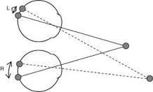
Stereo Camera Depth Estimation
One of the good and classic algorithms for depth estimation with vision is using stereo camera. (more detail link)
https://github.com/LearnTechWithUs/Stereo-Vision

Slide 34
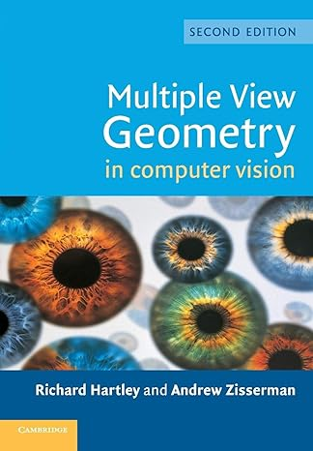
Deeper in the Topic
If you want to have more knowledge in this field, you can read this book:
Multiple View Geometry in Computer Vision
Or if you need good library to have better visualize in opencv, then use:
OpenCV Viz
Calib3d
It is good to take around 30 to 50 pictures with both cameras.
https://docs.opencv.org/2.4/doc/tutorials/viz/table_of_content_viz/table_of_content_viz.html
https://www.amazon.com/Multiple-View-Geometry-Computer-Vision/dp/0521540518

Slide 35
More links
https://docs.opencv.org/2.4/modules/calib3d/doc/camera_calibration_and_3d_reconstruction.html
Create your calibration pattern: https://docs.opencv.org/3.4/da/d0d/tutorial_camera_calibration_pattern.html
Nice Example of the calibration: https://github.com/EveryWhereLab/camera-calibration-using-opencv-python

Slide 36
Useful links
The OpenCV calib3d library contains many useful functions for this process and Google is your friend for more details on how to apply them.
Also see: OpenCV with stereo 3D reconstruction, OpenCV 3D reconstruction using shipped images and examples
Lot of resource tutorials and stereo vision cameras:
http://www.intorobotics.com/fundamental-guide-for-stereo-vision-cameras-in-robotics-tutorials-and-resources/

Slide 37
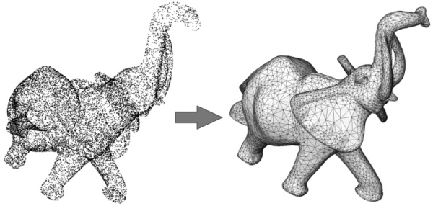
Points cloud to mesh
https://doc.cgal.org/latest/Poisson_surface_reconstruction_3/index.html#Chapter_Surface_Reconstruction_from_Point_Sets

Slide 38
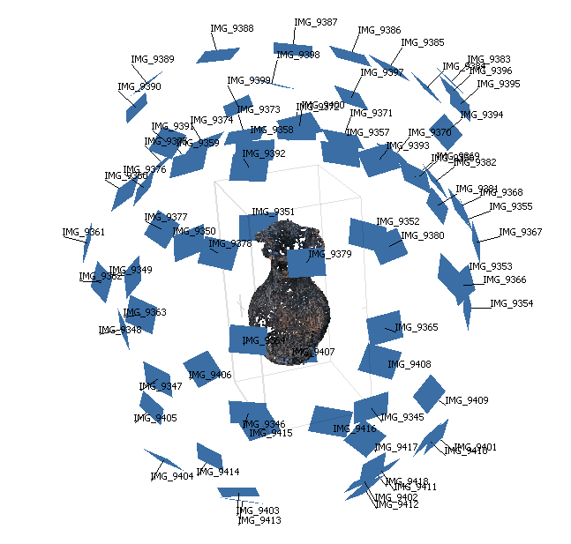
360 degree images
https://agisoft.freshdesk.com/support/solutions/articles/31000155265-how-to-build-a-complete-360-degree-model-of-an-object

Slide 39
Best tutorial
https://gilscvblog.com/2014/05/15/an-easy-and-practical-guide-to-3d-reconstruction/
The procedure for building a 3D model is the following:
Take images of the object with your camera from multiple view points. The object should contain texture and shouldn’t have any transparent parts such as windows. Rotate around the object and take an image every few degrees. I used 51 images to create the reconstruction above.

Slide 40
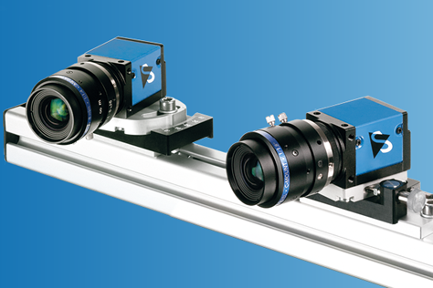
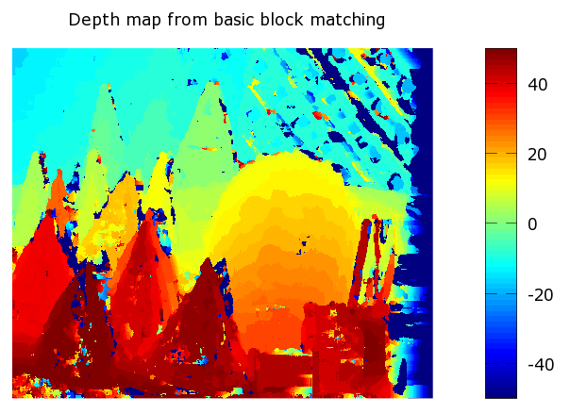
Depth map from basic block matching

Slide 41
Final useful app , newest algo(odometery)
https://github.com/ZhenghaoFei/visual_odom

Slide 42
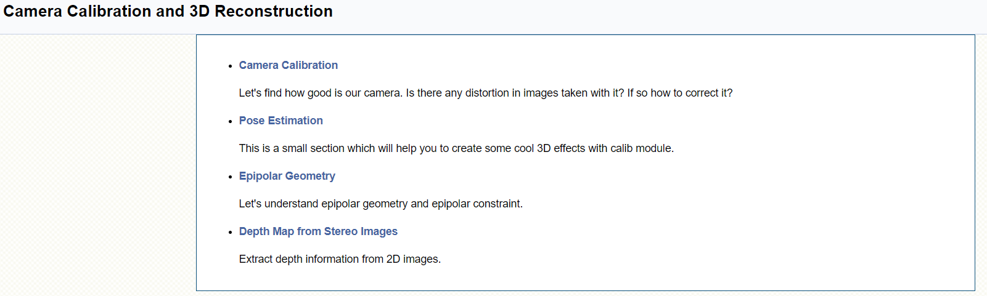
OPENCV guide
https://docs.opencv.org/4.x/d9/db7/tutorial_py_table_of_contents_calib3d.html

Slide 43

Camera calibration for kitti00 dataset’s camera
https://github.com/ZhenghaoFei/visual_odom/tree/master/calibration , example:
Camera.fx: 718.8560 # Camera calibration and distortion parameters
Camera.fy: 718.8560 # Camera calibration and distortion parameters
Camera.cx: 607.1928 # Camera calibration and distortion parameters
Camera.cy: 185.2157 # Camera calibration and distortion parameters
Camera.bf: -386.1448 # stereo baseline times fx
ThDepth: 35 # Close/Far threshold. Baseline times.
KITTI is a dataset for autonomous driving developed by the Karlsruhe Institute of Technology and Toyota Technological Institute at Chicago.

Slide 44
StereoBM smooth result
There are some parameters when you get familiar with StereoBM, and you may need to fine tune the parameters to get better and smooth results. Parameters:
texture_threshold: filters out areas that don't have enough texture for reliable matching
Speckle range and size: Block-based matchers often produce "speckles" near the boundaries of objects, where the matching window catches the foreground on one side and the background on the other. In this scene it appears that the matcher is also finding small spurious matches in the projected texture on the table. To get rid of these artifacts we post-process the disparity image with a speckle filter controlled by the speckle_size and speckle_range parameters. speckle_size is the number of pixels below which a disparity blob is dismissed as "speckle." speckle_range controls how close in value disparities must be to be considered part of the same blob.
Number of disparities: How many pixels to slide the window over. The larger it is, the larger the range of visible depths, but more computation is required.
min_disparity: the offset from the x-position of the left pixel at which to begin searching.
uniqueness_ratio: Another post-filtering step. If the best matching disparity is not sufficiently better than every other disparity in the search range, the pixel is filtered out. You can try tweaking this if texture_threshold and the speckle filtering are still letting through spurious matches.
prefilter_size and prefilter_cap: The pre-filtering phase, which normalizes image brightness and enhances texture in preparation for block matching. Normally you should not need to adjust these.

Slide 45
Good pros and cons
https://baptistehudyma.github.io/en/post/monocular_depth_map/
Good videos: https://cvg.cit.tum.de/research/vslam/lsdslam?redirect=1

